Slide 1

Discovering Materials
Using the Highway Lane
Dr. Guillermo Avendano-Franco
Prof. James Lewis Prof. Aldo Romero

Slide 2
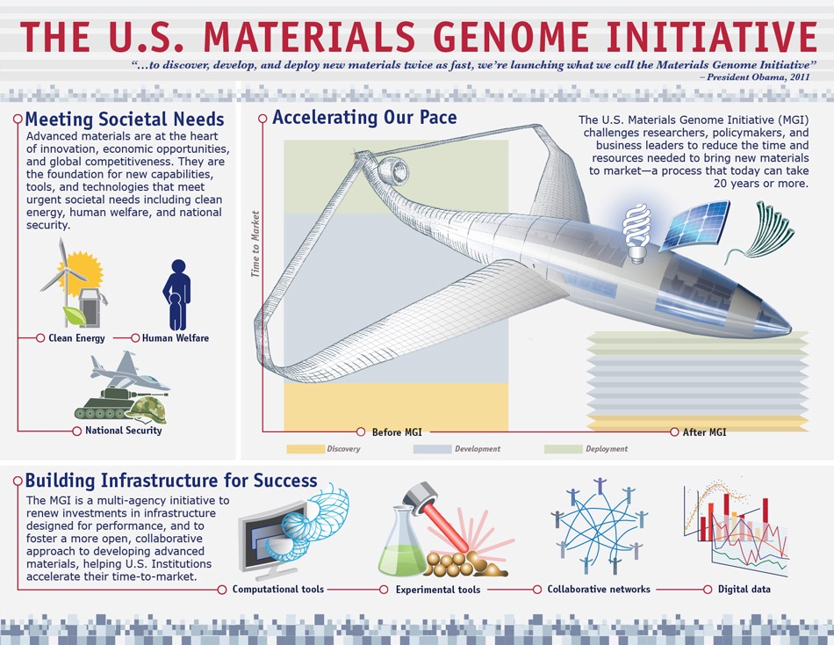
“…to discover, develop, and deploy new materials twice as fast, we are launching what we call the Materials Genome Initiative”
President Obama, 2011
…yet the time lag between discovery of advanced materials and their use in commercial products can be 20 years or more.
MGI Strategic Plan (Dec 2014)

Slide 3
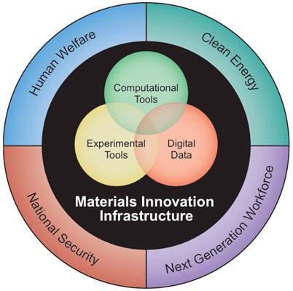
…to help businesses discover, develop, and deploy new materials twice as fast.
MGI Strategic Plan
(Dec 2014)
A $250 million research investment by DOE, NSF, and NIST
Anticipated 10-fold increase over the next decade.
https://www.whitehouse.gov/mgi/goals

Slide 4
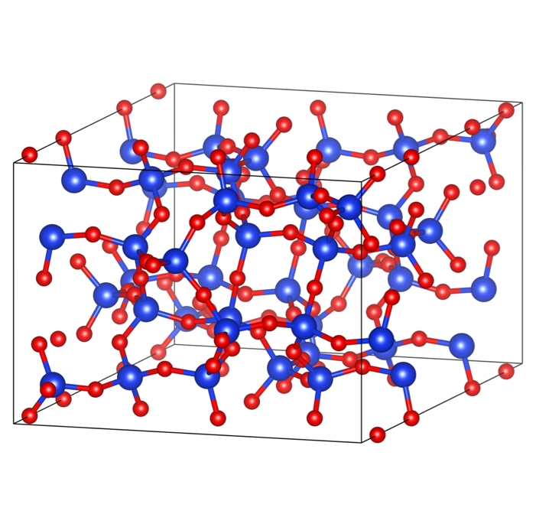
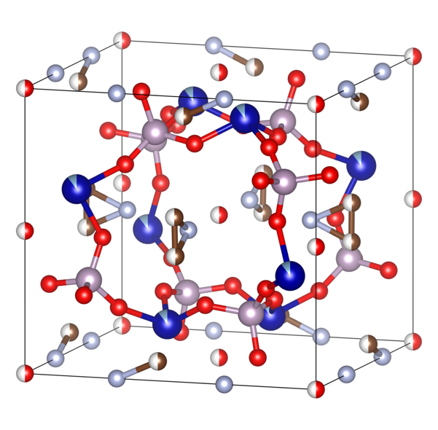
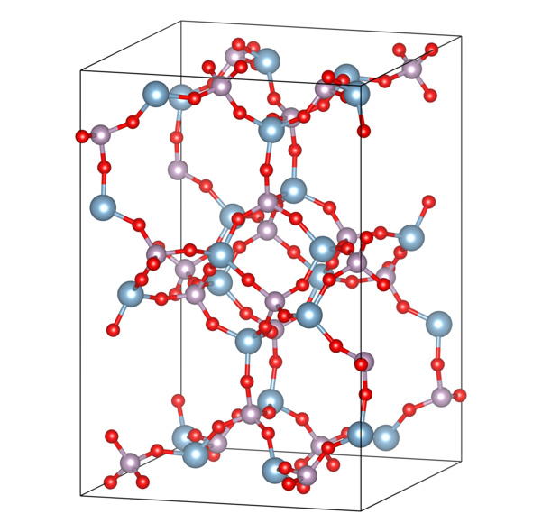
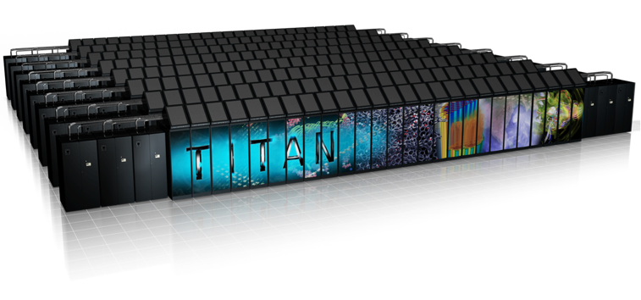
High-throughput materials discovery

Slide 5
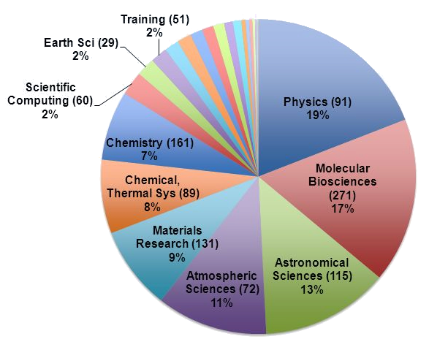
Computational Materials
Research
According to XSede usage (2015)

Slide 6
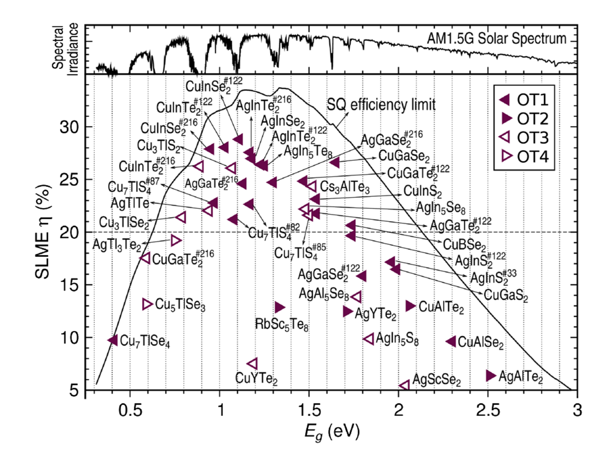
HTC for Energy Materials
Photovoltaics: HT screening of light-absorbing materials.
Spectroscopic limited maximum efficiency (SLME) versus the minimum gap (Eg) for generalized I–III–VI chalcopyrite materials identified as having a high SLME.
All of the currently used PV absorbers were found as well as new materials with promising
values (with SLME > 20%).
Yu, L. & Zunger, A. Phys. Rev. Lett. 108, 068701 (2012)

Slide 7
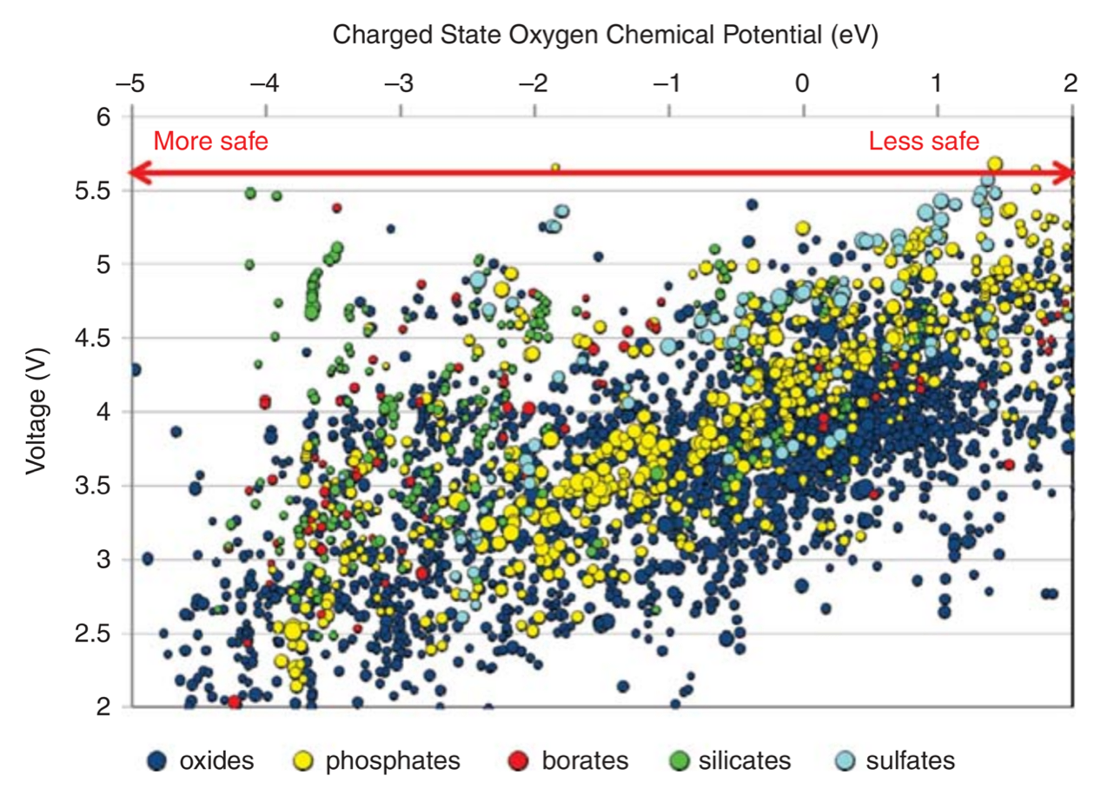
HTC for Energy Materials
Li-ion batteries: HT calculations of charge capacity vs Voltage
Calculated lithium insertion voltage versus theoretical capacity for several
thousand compounds.
The compounds are classified into oxides, phosphates, borates, silicates and sulfates.
Ceder G. Mater. Res. Soc. Bull. 35, 693–701 (2010).

Slide 8
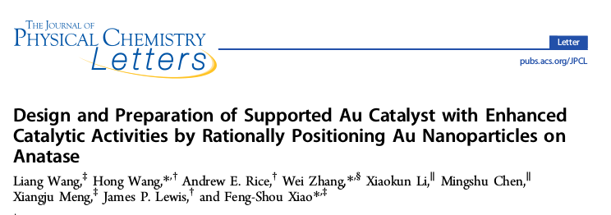
Au nanoparticles on Anatase (TiO2)
DOI: 10.1021/acs.jpclett.5b00655
… we have developed an efficient way to boost the activity of Au nanocatalysts. Coupling computational models with synthesis and characterization, the cooperation between Au and anatase is significantly enhanced by rationally positioning the Au nanoparticles on the edged/corner sites.
… Au nanoparticles positioned on the edge/corner sites of TiO2 supports offers an excellent opportunity for designing and developing highly “controlled” catalysts in the future.

Slide 9
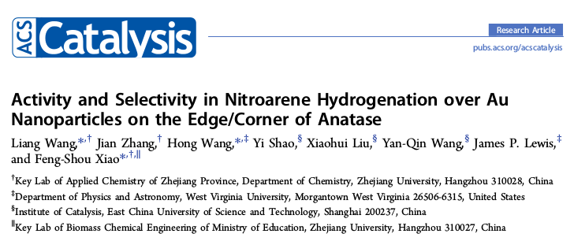
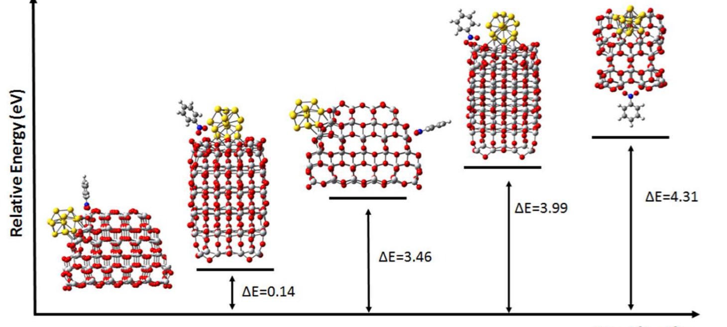
Nitroarene Hydrogenation
DOI: 10.1021/acscatal.6b00530

Slide 10
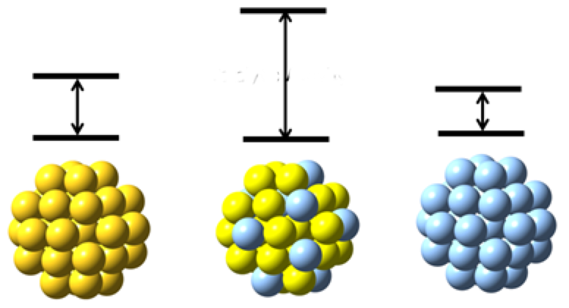
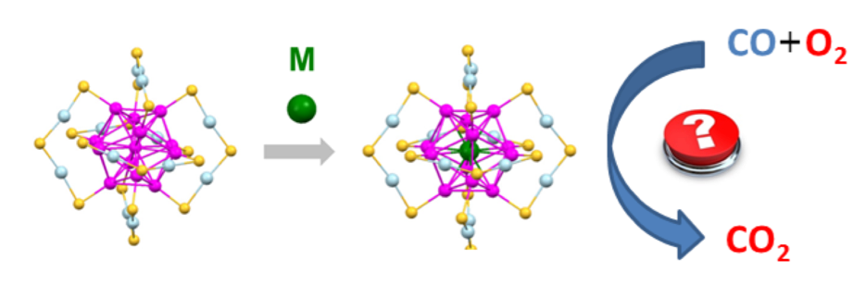
Bi-metallic nanoparticles
Catalytic activity is enhanced by a smart combination of transition metals compare to the activity of their precursors. Doping center atom will significantly change catalytic properties
Hg, Ag doping both suppress CO oxidation, but enhance hydrogenation activity.
CO and CO2 conversion and biomass hydrogenation

Slide 11
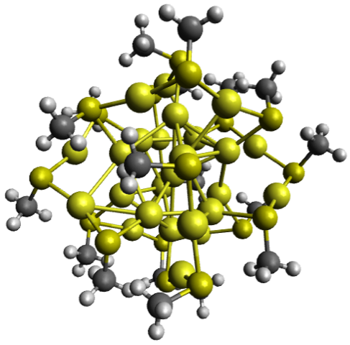
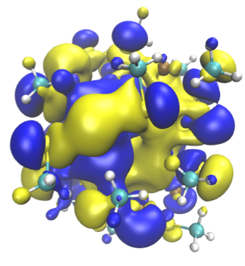
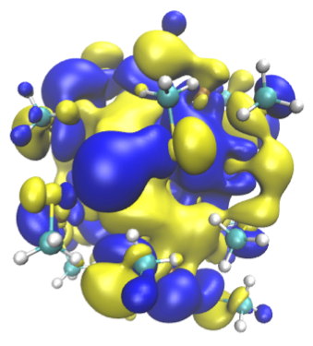
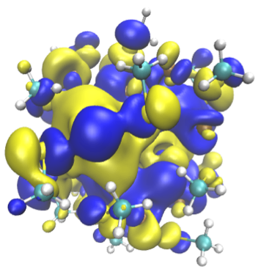
Bi-metallic nanoparticles
Ag Doped
(outer)
(inner)
Au25(SCH3)18
Undoped

Slide 12
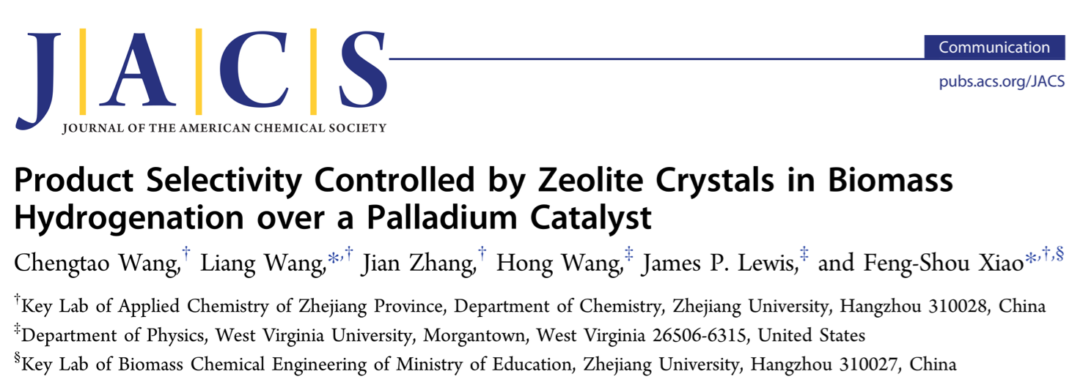
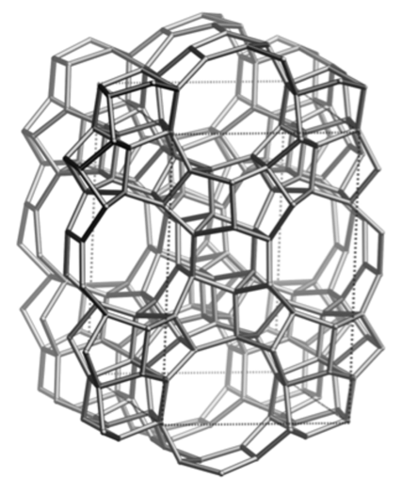
Zeolites
DOI: 10.1021/jacs.6b04951
The key to this success is to combine the advantages of both Pd nanoparticles (highly active sites) and zeolite micropores (controllable diffusion of reactants and products).
In the hydrogenation of biomass-derived furfural, the furan selectivity over the Pd@S-1 is as high as 98.7%, outperforming the furan selectivity (5.6%) over conventional Pd nanoparticles impregnated with S-1 zeolite crystals (Pd/S-1).

Slide 13
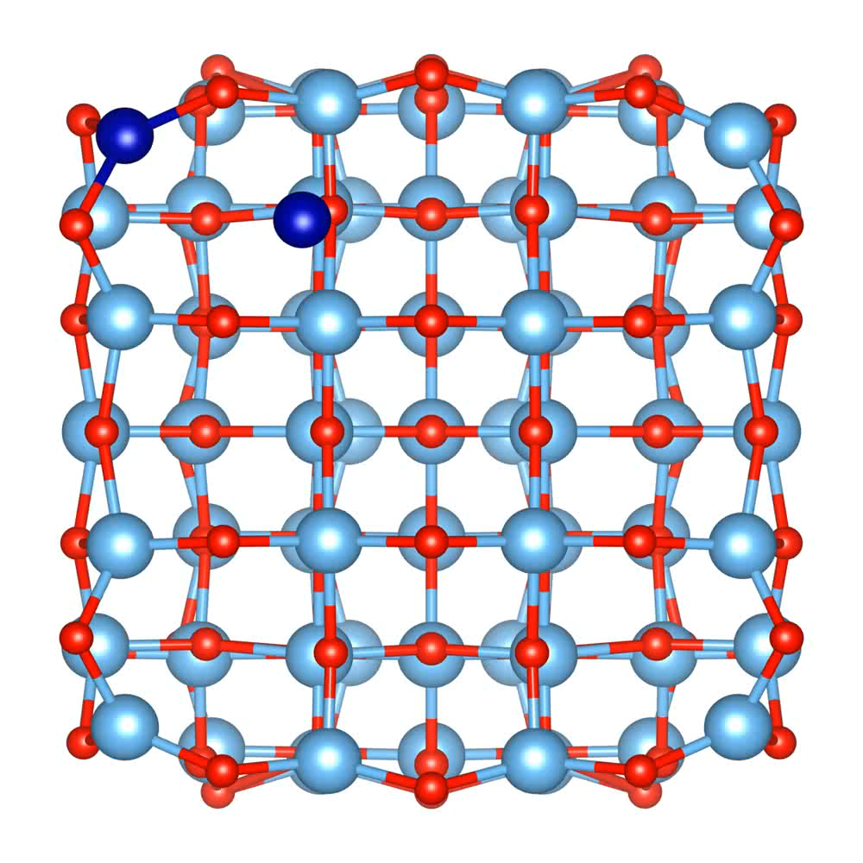

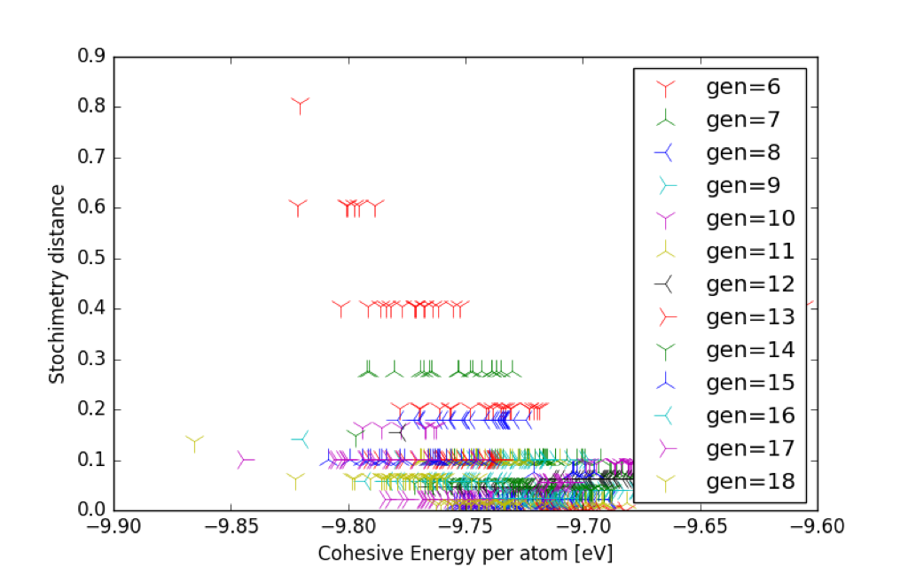
C3O4 cluster growing on TiO2
Cluster growing simulation using a tree search algorithm and a double stoichiometry and energy
selectivity.
308 atoms for TiO2

Slide 14






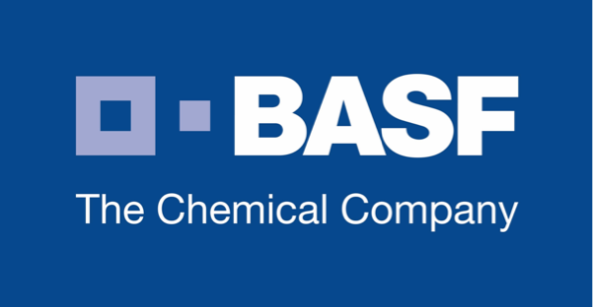
Funding
DOE Basic Energy Science – Program for Computational and Theoretical Chemistry
Designing Materials to Revolutionize and Engineer Our Future (with Rongchao Jin – CMU)
International Center of Excellence – Catalysis (with Prof. Feng-Shou Xiao – Zhejiang University)
3+ indirect patents

Slide 15
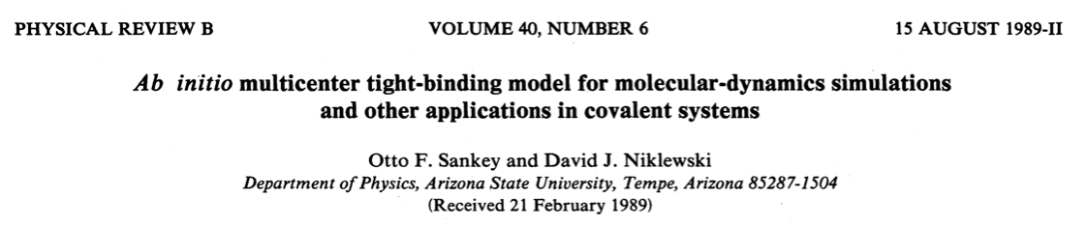

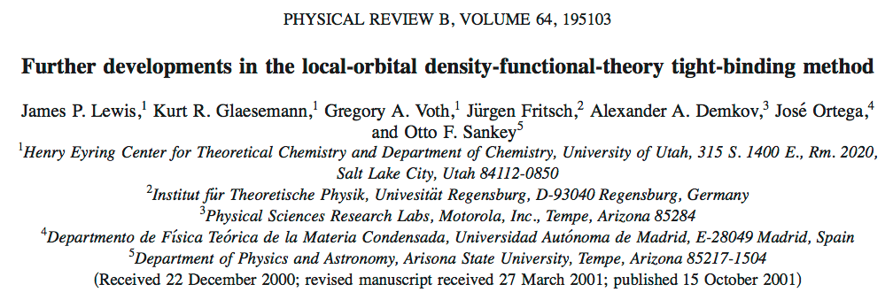

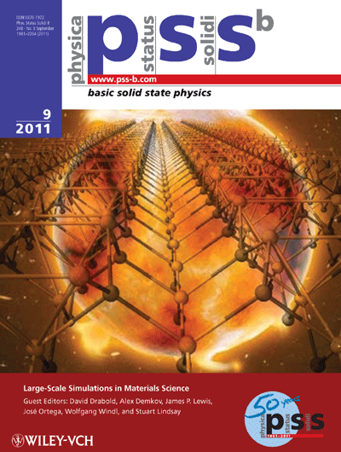
Fireball
FIREBALL is a suite of programs designed to perform calculations using ab initio tight-binding molecular dynamics, having favorable accuracy/efficiency balance Based on TB-DFT (Tight-Binding Density Functional Theory).
Fireball code is an efficient first-principles exploratory tool allowing to handle complex systems including thousands of atoms.

Slide 16
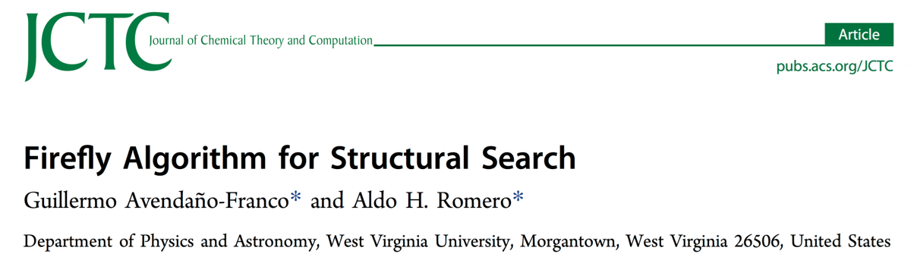
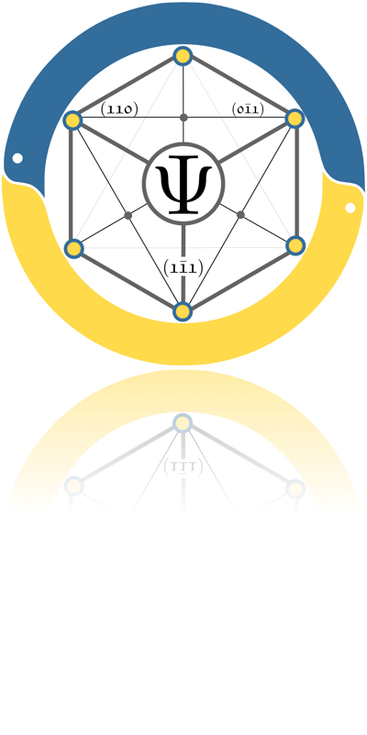
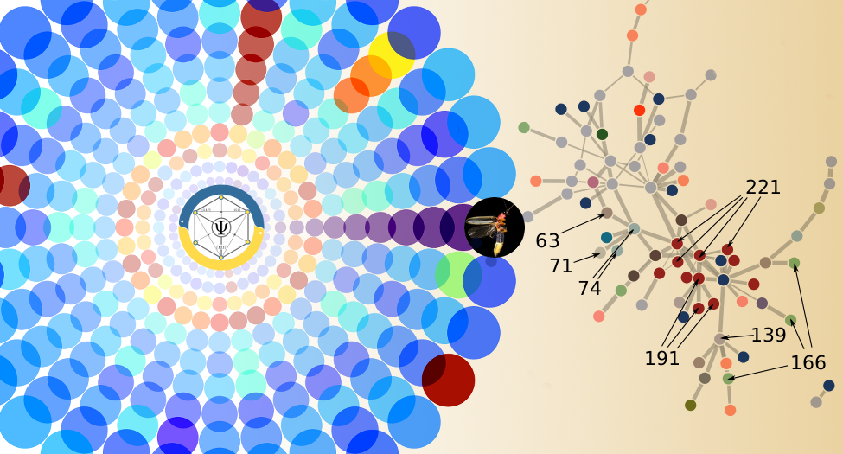

PyChemia
PyChemia is a open-source Python library for High-throughput first-principles materials discovery. The focus of this library is on structural search and data analysis. The ultimate purpose of the code is to optimize the search of new materials using a variety of soft-computing-based and statistical methods.

Slide 17

Conclusions
Computers as a fast lane for materials discovery, cutting costs and time-to-market.
We show some cases for energy materials.
We present the several studies on the area of catalysis with metals on anatase, growing and optimization with bimetallics.
The tools (Fireball, PyChemia) used for HT calculations for large numbers of atoms.
Only HT methodologies can explore the diversity of catalytic processes and its optimization.

Slide 18

https://github.com/fireball-dft/slides
Thank you

